Slide 1
Fundamentals of Data Engineering
Manasa Hari
April 30th, 2025

Slide 2

A quick intro about me
https://www.linkedin.com/in/harimanasa/

Slide 3


What is
Data Engineering?
02
Data engineering is the development, implementation, and maintenance of systems and processes that take in raw data and produce high-quality, consistent information that supports downstream use cases, such as analysis and machine learning. Data engineering is the intersection of security, data management, DataOps, data architecture, orchestration, and software engineering. A data engineer manages the data engineering lifecycle, beginning with getting data from source systems and ending with serving data for use cases, such as analysis or machine learning.

Slide 4
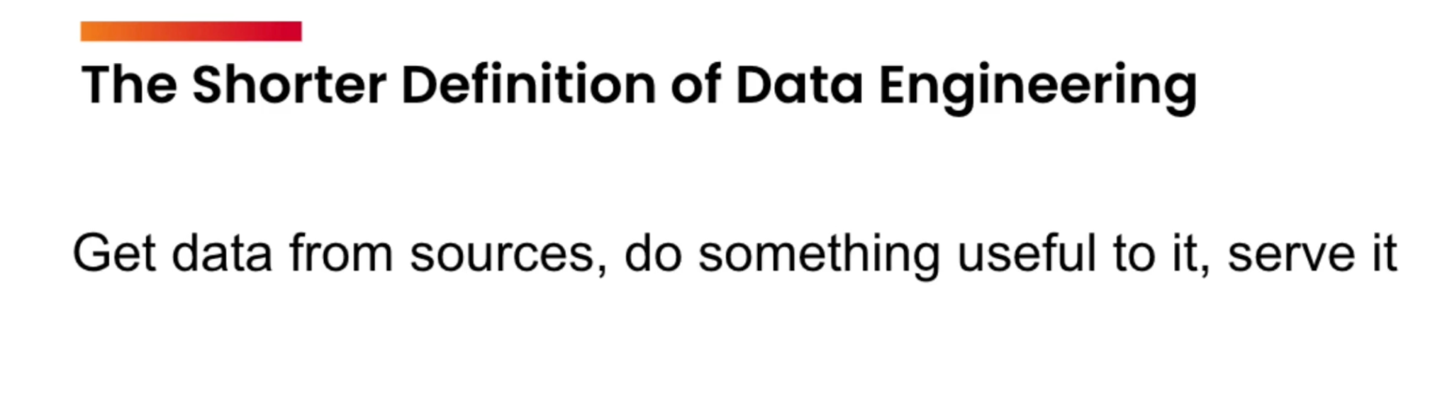

Slide 5
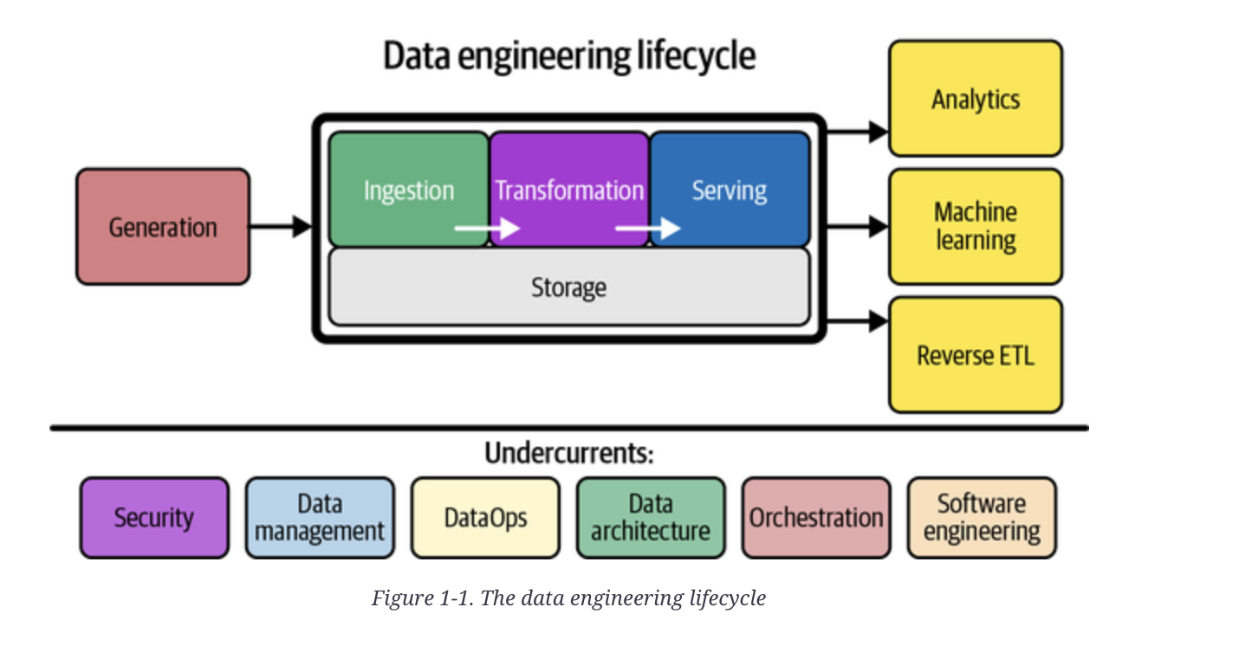
Data Engineering Lifecycle

Slide 6
Data Engineering Lifecycle
Step 1: Generation
Step 2: Ingestion
Step 3: Storage
Step 4: Transformation
Step 5: Serving
Data is created at source (apps, sensors, logs).
Bringing data in (batch/stream).
Persisting data efficiently.
Cleaning, structuring, enriching data.
Delivering the final form to users, APIs, dashboards.
A real-world example: A mobile app like Uber creates data (Generation), collects it using Kafka (Ingestion), stores it in S3 (Storage), transforms it using Spark (Transformation), and delivers it to dashboards (Serving).

Slide 7
Step 1 & 2 - Generation & Ingestion
Step 1: Generation
Step 2: Ingestion
Data is created at source (apps, sensors, logs).
Bringing data in (batch/stream).
Technologies:
Kafka: Event streaming. Used for real-time logs, e.g., Uber's ride data.
NiFi: Visual ETL, great for legacy ingestion.
AWS Kinesis: Managed streaming on AWS. Used by Netflix.
Examples:
IoT sensor data streaming in real-time (Kafka).
Daily batch export of transaction logs (Airflow + S3).
Analogy: Streaming is like live TV; batch is like recording a show and watching later.

Slide 8
Data Engineering Lifecycle
Step 1: Generation
Step 2: Ingestion
Step 3: Storage
Step 4: Transformation
Persisting data efficiently.
Storage Technologies:
S3 / GCS / Azure Blob: Cheap, durable object storage.
Snowflake: Cloud-native warehouse with elastic compute.
Delta Lake: Adds reliability to raw data lakes.
Transformation Tools:
Apache Spark: Scalable batch + stream processing.
Examples:
Store raw JSON files from app logs in S3
Use dbt to build dimensional models → Query in Snowflake.
Note: Emphasize schema evolution and tracking data lineage.

Slide 9
Data Engineering Lifecycle
Step 1: Generation
Step 2: Ingestion
Step 3: Storage
Step 4: Transformation
Step 5: Serving
Serving is where value is realized. It’s how we make data usable for business.
Serving Methods:
Dashboards (Tableau, Looker)
APIs (Flask, FastAPI)
Direct SQL Access (via Redshift, BigQuery)
Undercurrents:
Orchestration: Apache Airflow to schedule workflows.
Security: IAM roles, encryption, audit trails.
DataOps: Version control, CI/CD for data pipelines.
Analogy: Serving is plating the meal. Orchestration is the head chef making sure all dishes come out together.

Slide 10
Real-World Case Study
Let’s walk through a simplified version of Netflix’s data platform.
Generation: App logs (play/pause/search).
Ingestion: Kafka collects events.
Storage: Stored in S3 and Delta Lake.
Transformation: Processed using Spark jobs.
Serving: Data exposed to ML models for recommendations.
Can you think of the most important aspects?

Slide 11
❓ When would you use a data lake vs. a data warehouse?

Slide 12
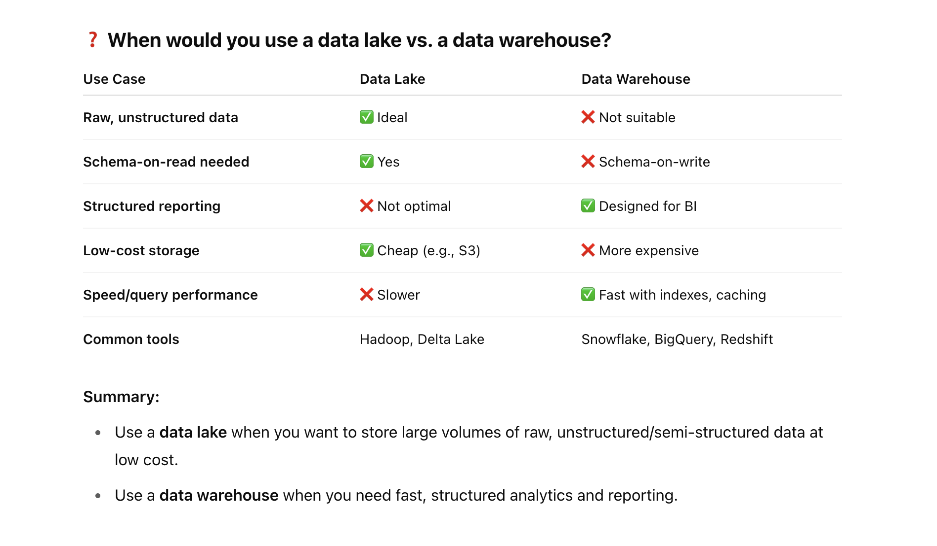
❓ When would you use a data lake vs. a data warehouse?

Slide 13
Thank you!

